Slide 1

Department of ECE
Analog electronic Circuit Design
24ec2104
Topic:
Operational amplifier (Op-Amp)
-basics

Slide 2



AIM OF THE SESSION
The aim of this session is to emphasize the significance of Operational Amplifier and to understand the basics of Op-Amp.
INSTRUCTIONAL OBJECTIVES
This Session is designed to:
  Specify the importance/necessity of the Operational Amplifier (Op-Amp).
  Describe the function of each block of the Op-Amp block diagram.
  Understand the Pin diagram and schematic symbol of the Op-Amp.
LEARNING OUTCOMES
At the end of this session, you should be able to:
  Explain the basic working principle of Op-Amp.
  Summarize the functioning of each block of Op-Amp internal diagram.
  Identify the Pin configuration and importance of IC741.

Slide 3
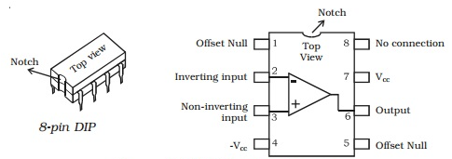
Significance/Necessity of Op-Amp
Operational Amplifier, usually known as Op-Amp is a differential amplifier widely used in Electronic Circuits. It can be used to build circuits for mathematical operations, buffers, wave generators, amplifiers, etc. Op-amp is a basic building block in many important analog electronic circuits because of the following reasons:
Its characteristics are near to the ideal one
It is very easy to design
It provides high reliability
They work at different levels quite close to the theoretical performance
It can be available in small packages
Reduced cost and stable performance against temperature variations

Slide 4
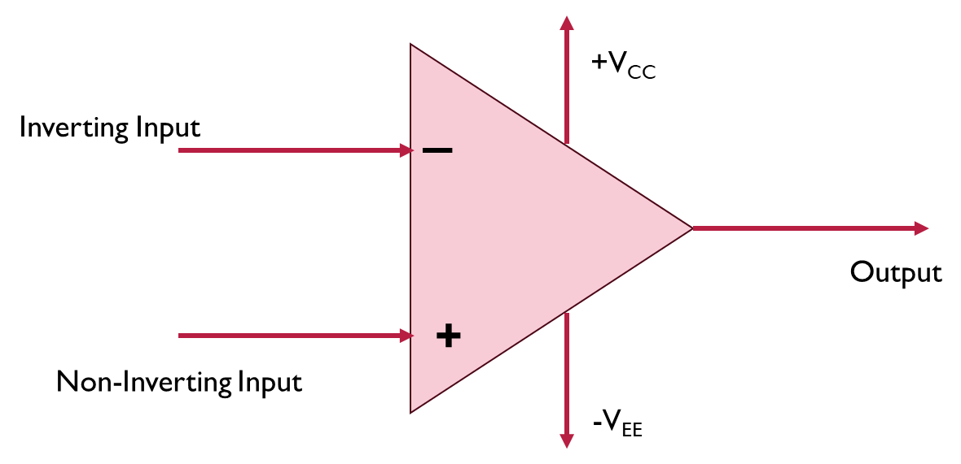
INTRODUCTION
An Op-Amp is a direct coupled high gain amplifier consisting of one or more differential amplifiers and usually followed by a level translator and an output stage (push-pull or push-pull complementary symmetry pair).
It is designed for performing mathematical operations like addition, subtraction, integration, and multiplication- hence the name Op-Amp.
By including the external feedback components, Op-Amp can be used in various applications which include, ac/dc amplifiers, active filters, oscillators, comparators, regulators, etc.

Slide 5
Block Diagram of Op-Amp
Inverting Input
Input Stage
Intermediate Stage
Level Shifting Stage
Output Stage
Output
Non-Inverting Input
Dual-Input
balanced-output
differential amplifier
Dual-Input
unbalanced-output
differential amplifier
Like Emitter follower
using constant current
source
Complementary
Symmetry Push-pull
Amplifier

Slide 6
Block Diagram of Op-Amp- Description
The input stage is a dual-input, balanced output differential amplifier which usually provides most of the voltage gain of the amplifier.
The intermediate stage is a dual-input, unbalanced (single-ended) output differential amplifier. DC voltage will be above the ground potential because of direct coupling.
Level translator is used after the intermediate stage to shift the DC level at the output of the intermediate stage to zero volts with respect to ground.
The output stage is a push-pull complementary amplifier that increases the output voltage swing and raises the current supplying capability of the Op-Amp along with low output resistance.

Slide 7
Schematic Symbol of Op-Amp
An ac signal (dc voltage) applied at non-inverting input produces in-phase (same polarity) signal at the output.
An ac signal (dc voltage) applied at inverting input produces a 180º out-of-phase (opposite polarity) signal at the output.
+V_{CC}
Inverting Input
v₂
v₀
A
Output
v₁
+
Non-Inverting Input
V₁= voltage at non-inverting input
V₂=voltage at the inverting input
V₀=Output voltage
A= large signal voltage gain (specified in the datasheet)
-V_{EE}

Slide 8
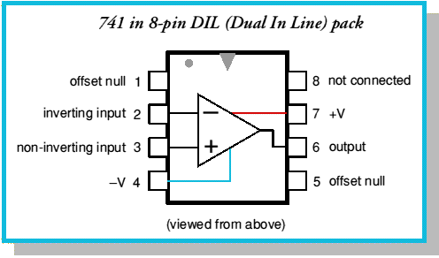
Pin Diagram of IC741
Op-Amps are available in Integrated Circuit (IC) form.
General purpose Op-Amp is IC 741 or IC 351 and can be used for applications like integrator, differentiator, summing amplifier, etc.
µA741- Fairchild; LM741- National Semiconductor; N5741-Signetics
IC741Cis a commercial-grade Op-Amp with operating temperature range as 0º to 70º/75ºC.
Supply voltages of Op-Amp are ± 15 V.
Special purpose IC like LM380 Op-Amp can be used only for audio power applications.

Slide 9

SUMMARY
Operational Amplifier (Op-Amp) is a basic building block in Analog electronic circuits.
The session covered the necessity and basic working principle of Op-Amp with the help of block diagram approach.
The pin configuration of IC 741 has been discussed along with the schematic symbol of Op-Amp.

Slide 10
SELF-ASSESSMENT QUESTIONS
Operational Amplifier is used in
Amplifiers
Integrator
Subtractor
All the above
Level Shifter stage is needed in Op-Amp for
shifting the DC level to zero introduced by the intermediate stage
introducing DC level to the output of intermediate stage
to improve the signal amplitude
None of the above

Slide 11
SELF-ASSESSMENT QUESTIONS
3. The output of the Op-Amp will be _______ with Input signal applied at Non-Inverting terminal..
270 degrees
180 degress out-of-phase
In-phase
None of the above
4. IC741 is a
General purpose Linear IC
Special Purpose Op-Amp
Both
None of the above

Slide 12
ANSWERS
d
a
b
a

Slide 13
TERMINAL QUESTIONS
Illustrate the significance of each block and discuss the basic working principle of Op-Amp.
Sketch the schematic symbol of Op-Amp.
Show the pin diagram of IC741 and discuss the importance of each pin..
List the applications of Op-Amp in electronics

Slide 14
REFERENCES FOR FURTHER LEARNING OF THE SESSION
Reference Books:
1. Op-Amps and Linear Integrated Circuit; 4th Ed., Gayakwad, Ramakant A.
Sites and Web links:
1. https://electronicsforyou.in/introduction-to-op-amp

Slide 15
THANK YOU
Team – AECD

